Slide 1
Sentiment Analysis of Twitter Data
Amulya Nayak
Suhasini KL
Bharath Kumar Karre
Manjusha
Shruti Suryawanshi

Slide 2
Introduction
Expression of real-time opinions through text, blogs, reviews, and tweets on a variety of topics to discuss on a range of content like current issues, complaints, and review of products.
In the recent day’s companies producing or launching a new product, scrap the web for any information related to the product and get the sentiment that is associated with the product.
Goal
Classifying the sentiment by extracting the data from Twitter to gauge the sentiment of the tweets into positive, negative and neutral.
This projects aim is to gauge the sentiment of the people for the upcoming Indian general elections.

Slide 3
Related Work
Go, Bhayani and Huang (2009):
Collected training dataset directly from Twitter in order to classify the tweets as a negative or positive sentiment.
They had tried various features like unigram, bigram, and part of speech to train their model and classify using Naïve Bayes, Support vector machine and maximum entropy.
They had concluded that Naïve Bayes is the best classifier and bigrams alone are not helpful for sentiment prediction.
Pak and Paroubek (2010):
They identified that using creative and inform language make it difficult to analyze the tweets.
They have leveraged the previous work done in this field using the #tag to build their classifier.
They have used Edinburgh twitter dataset to manually annotate the hashtags and run the classifier on the corpus to classify the sentiment

Slide 4
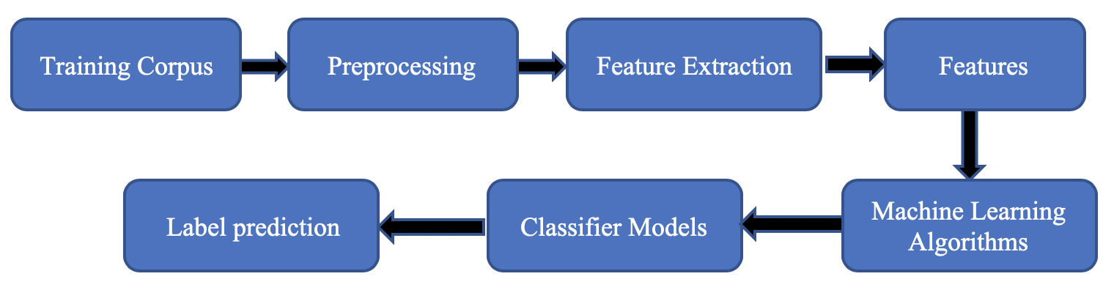
Approach

Slide 5
Pre-Processing
User-generated data that is available on the web is not present in the form so that it can be directly used for learning of the model.
We have applied an extensive set of pre-processing to decrease the feature size to make it suitable for machine learning algorithms.
Hashtags: A phrase that is prefixed with # in order to target a specific topic and increase the visibility by generating more no of tweets for that particular topic.
Ex: #Champions #football
Regular expression: #(\w+)
Replaced with: HASH_\1
2. Handels: Every user has a unique name that starts with @. So, any content that starts with an @ is directed towards a particular user.
Ex: @Microsoft, @umich
Regular expression: @(\w+)
Replaced with: HNDL_\1

Slide 6
Contd….
3. URLs: Users often use hyperlinks to share content from a different website in their tweet. Which is generally used to lead the user out of twitters domain. From the classification point of view, URLs don’t have any impact, but these URLs can contain valuable information pertaining to the tweets.
Regular expression: (http|https)://[a-zA-Z0-9\\./]+
Replaced with URL
4.Punctuations: Certain punctuations play an important role in expressing the sentiment of the text like exclamation which generally means excited, question mark, etc. each word boundary was replaced with the relevant punctuation and every single quote present in the text was removed. Ex. ‘.’ replaced with: PUNC_DOT
5. Emoticons: Emoticons are the most relevant part while extracting the sentiment from microblogging sites. Each emoticon was replaced with a word in the corpus. Ex. ‘:-), :), (:, (-:’ replaced with EMOT_SMILEY
6. Repeating Characters: When on a certain excited mood people often repeat or elongate the word. So, these characters are replaced as two words in the dataset. Ex: Gooooood, Hungryyyy
Regular expression: (.)\1{1,}
Replaced with: \1\1

Slide 7
Experiments:
Trying to find the best results by making different combination of features-
only unigrams
unigrams + bigrams and trigrams,
unigrams + negation
unigrams + bigrams and trigrams + negation.
Classifier used-
Naive Bayes
Maximum Entropy
Cross Validation
10 fold for each of the 10 parts

Slide 8

Naïve Bayes
It has been used because of its simplicity in both during training and classifying stage.
It is a probabilistic classifier and can learn the pattern of examining a set of documents that has been categorized.
It compare the contents with the list of words to classify the documents to their right category.
Class c* is assigned to tweet d, where, f represents a feature and ni (d) represents the count of feature f i found in tweet d. There are a total of m features. Parameters P(c) and P (f|c) are obtained through maximum likelihood estimates which are incremented by one for smoothing.

Slide 9
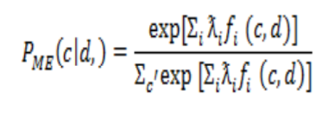
Maximum Entropy
Maximum entropy maximizes the entropy defined on the conditional probability distribution.
It even handles overlap feature and is same as logistic regression which finds distribution over classes.
It also follows certain feature exception constraints Where, c is the class, d is the tweet, and ƛ is a weight vector.
The weight vectors decide the significance of a feature in classification.

Slide 10
Conclusion
Data Set : Labelled(supervised)
Classifier : Naïve Bayes classifier is the only classifier we are implementing.
Naive Bayes classifier achieves highest average accuracy by implementing features
1. Unigrams+ negation detection gives accuracy 74.955%
2. Unigrams+ negation detection + higher order n-grams(bigrams and trigrams) 74.955%
Maximum Entropy classifier average accuracy is
1. Unigrams+ negation detection gives accuracy 73.024%
2. Unigrams+ negation detection + higher order n-grams(bigrams and trigrams) 73.024%
In conclusion, Naive Bayes achieves highest accuracy.

Slide 11
Future Work
Multilingual : Create a sentiment classifier applicable to many languages used in twitter. Ex. 22 official languages in India.
Semantic Analysis: Understanding nouns helps us classify a tweet better. Ex. If Apple and iphone used in the same line. Classifier should be able to identify “Apple” is a company and “iphone” is a product.

Slide 12
References
“Twitter as a corpus for sentiment analysis and opinion mining” by Alexander Pak and Patrick Paroubek
“Twitter sentiment analysis: The good the bad and the omg!” by Johanna Moore , Theresa Wilson and Efthymios Kouloumpis.

Slide 13
Thank You

Slide 14


